Slide 1

UNIVERSITY COLLEGE OF ENGINEERING
BIT CAMPUS, ANNA UNIVERSITY,TIRUCHIRAPPALLI-620 024
PROJECT TITLE-CS8811
DETECTION ON LEUKEMIA CANCER DATASET USING MACHINE LEARNING
Guided by Presented by
Mrs.K.Uma Maheswari D.Maheswaran (810020104710)
S.Vishnu (810020104085)
R.Yuvaraj (810020104089)

Slide 2
Abstract
Leukemia, A heterogeneous group of hematologic malignancies, presents unique challenges due to its varied subtypes and genetic abnormalities.
Leukemia cancer is a cautious disease, it is like a slow poison disease. It will grow slowly. The people have the pain in the bones or joints. Then the whole body will be affected like fatigue, fever, loss of appetite. These symptoms are not common to everyone. The common symptoms will be like bleeding, frequent infections, mouth ulcer, nose bleed, red spot on skin, shortness of breath, unintentional weight loss.
The Leukemia cancer dataset will be identified using digital image processing.
We have used the random forest model to create the dataset.
The dataset will be taken from the kaggle dataset.

Slide 3
Introduction
Blood has 3 types of cells namely white blood cells are the ones that fight with the infection , red blood cells usually carry oxygen and platelets helps in blood clotting.
When a person is diagonised with leukemia, the body produces more WBC than it actually needs and these leukemic cells could not fight with the infection in the body in the way normal WBC cells fight.
After sometime, it will result in a lack of RBC to supply oxygen enough platelets to clot your blood, or enough normal WBC to fight infection.
Leukemia can be broadly classified into Acute Leukemia and Chronic Leukemia.
Acute Leukemia can be cured as soon as it is detected.
Chronic Leukemia initially show no symptoms and can be undiagonised for several period of time.

Slide 4
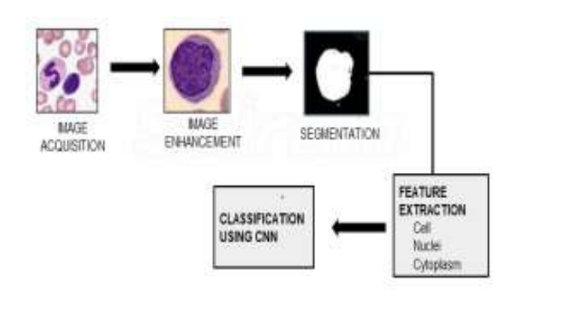
SYSTEM Architecture design to Proposed system

Slide 5
LITERATURE survey
S.NO | AUTHOR NAME | CONTENT | TECHNIQUE/METHODS
1. | MIRIAM SEOANE SANTOS,JOAO SANTOS | How distance metrics using image processing with K-nearest neighbours. | K-Nearest neighbour,CART(Classification and Regression tree).
2. | HAN AND KAMBER | Data mining concepts and techniques. | K-nearest neighbour.

Slide 6
3. | CHING-HSUE CHENG,JING-RONG CHANG | A novel weighted distance threshold method for handling medical missing values. | K-nearest neighbour, imputation method
4. | SHAHITUL ISLAM KHAN AND ABU | An improved CNN technique | K-nearest neighbour,CART (Classification and regression tree)

Slide 7
Algorithms/techniques used with complexity
Using cnn Algorithm the process of identifying the leukemic cells is performed which provides most accurate diagnosis.
this project makes use of machine learning technique namely random forest model to detect the leukemic cells. I t had an accuracy of 94.3%.This classifier performs test on 65 sample images which seemed to be less accurate.
SVM classifier was used for classification of the white blood cells into normal and leukemic cells. The over all accuracy was around 90%.

Slide 8
Algorithms/techniques used with complexity
We have downloaded datasets which are available publicly from the Kaggle website.
The dataset is basically the peripheral blood smear images(PBS).These PBS images are obtained from blood samples which are basically stained using microscopic slides in the laboratory.
In our project 13000 samples are used as the input datasets of which 80% is used for training and remaining 20% for testing.

Slide 9
PROPOSED SYSTEM
In the proposed system , peripheral blood smears images which are microscopic images of the blood samples are taken as input datasets.
Feature extraction is followed by segmentation process and various features including cell structure . size, nuclei ,cytoplasm are extracted finally classification is done using CNN with which we detect leukemia and hence the lives of millions of people can be saved by detecting it in a very early stage.

Slide 10
Expected Outcomes
30% code Implementation Outcomes:
Output 1:

Slide 11
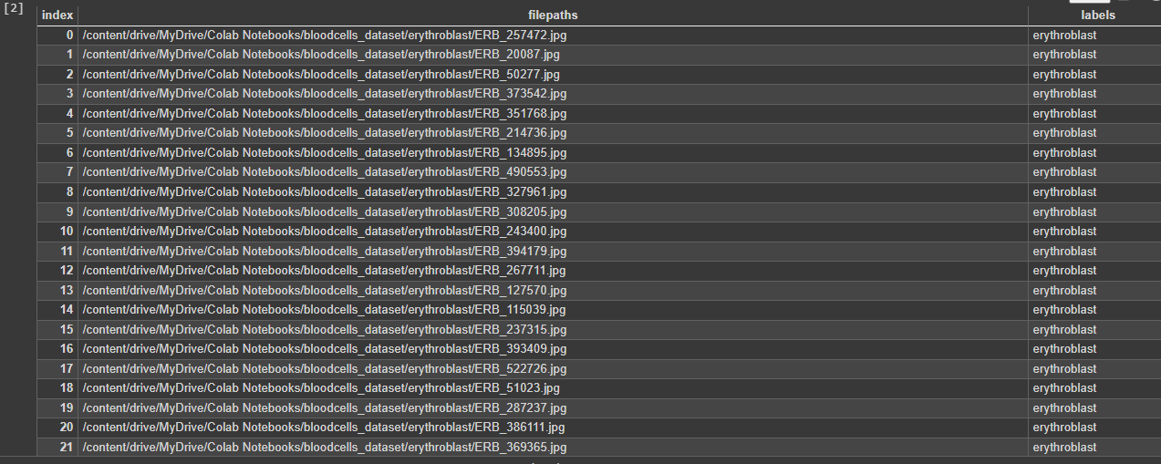
Expected Outcomes
Output 2:

Slide 12

Expected Outcomes
Output 3:

Slide 13
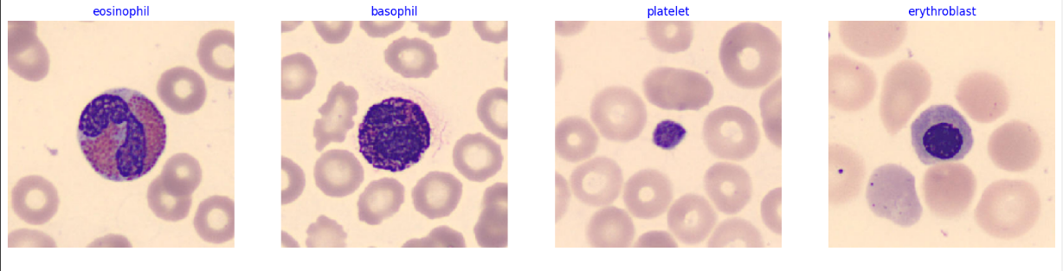
Expected Outcomes
Output 4:

Slide 14
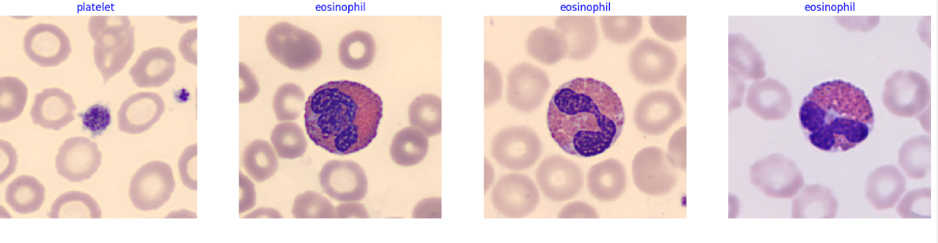
Expected outcomes
Output 5:

Slide 15
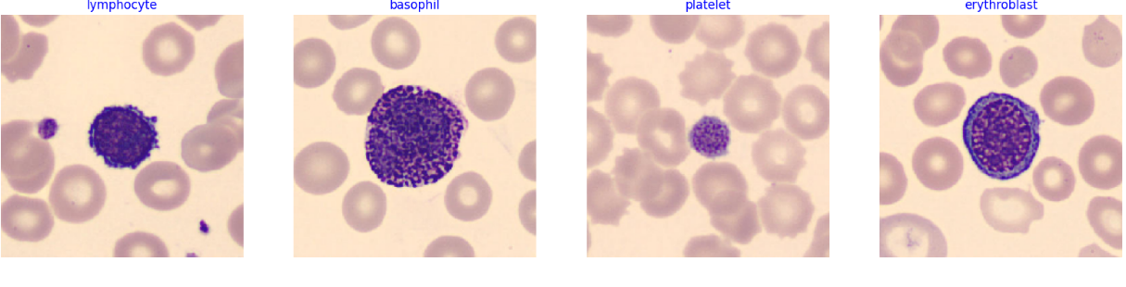
Expected Outcomes
Output 6:

Slide 16
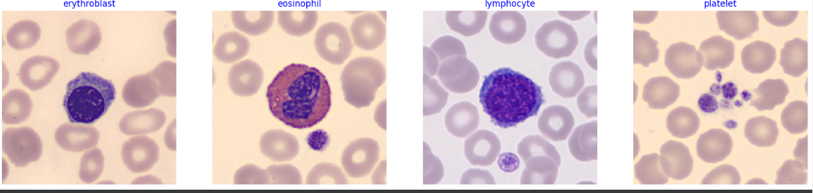
Expected outcomes
Output 7:

Slide 17
MODULES
MODULE 1: Data Processing is the first stage of classification process. Blood spear images can be taken as input data set and further they are resized, filtration happens, noises are removed and edges are smoothened.
MODULE 2:Datasets are available publicly from the Kaggle website. The dataset is basically the peripheral blood smear images(PBS).
MODULE 3:Classification of Leukemia Cells.
MODULE 4: Finally random forest, SVM, decision tree, CNN , logistic regression, xgboost classifier is compare the accuracy.

Slide 18
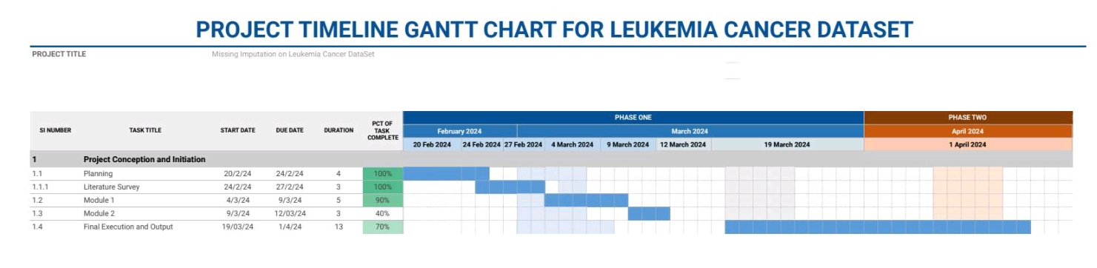

Slide 19
REFERENCES
1.D.R. Wilson , T.R. Martinez , Improved heterogeneous distance functions, J. Artif. Intell. Res. 6 (1997) 1–34 .
2. G. Tutz , S. Ramzan , Improved methods for the imputation of missing data by nearest neighbor methods, Comput. Stat. Data Anal. 90 (2015) 84–99 .
3.M.S. Santos , J.P. Soares , P.H. Abreu , H. Araújo , J. Santos , Influence of data distriBution in missing data imputation, in: Conference on Artificial Intelligence in Medicine in Europe, Springer, 2017, pp. 285–294 .
4. Alghasham N, Alnounou R, Alzahrani H, Alsharif F. Plasma cell leukemia: Clinicopathologic, immunophenotypic and cytogenetic characteristics of 4 cases. Hematol Oncol Stem Cell Ther. 2015;8:71-7 pubmed publisher

Slide 20
THANKING YOU

